Slide 1
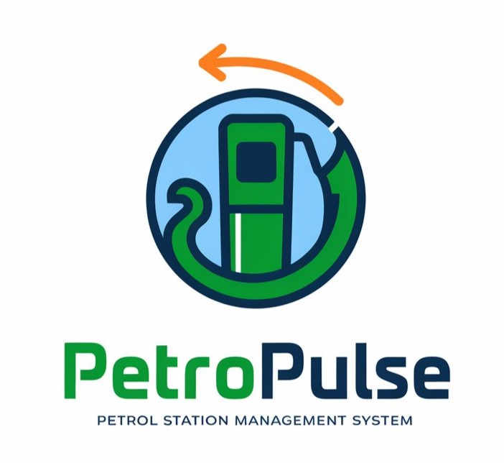
PetroPulse
Hasnain Akhtar 22i-1241
Anas Bin Rashid 22i-0907
Adan Malik 22i-1000

Slide 2
Introduction
The purpose of PetroPulse is to provide a petrol station management system that streamlines sales, fuel orders, payments, customer loyalty, and administrative tasks by defining its functional and non-functional requirements.
Problem: The issues that led to the creation of PetroPulse include inefficient manual processes, lack of real-time data, high administrative burdens, customer dissatisfaction due to slow transactions, and operational challenges in inventory tracking and fuel ordering. PetroPulse aims to solve these problems with an automated solution.

Slide 3
Scope & Objectives
PetroPulse offers a comprehensive solution for managing petrol stations, integrating fuel station management, inventory tracking, payment processing, customer management, and worker scheduling. It enables seamless interaction between owners, workers, and customers, with role-based access for efficient operations.
Objectives: The main objectives of PetroPulse are to automate operations, ensure accurate financial management, monitor inventory, simplify employee scheduling, enhance customer service, and provide data analytics for informed decision-making.

Slide 4
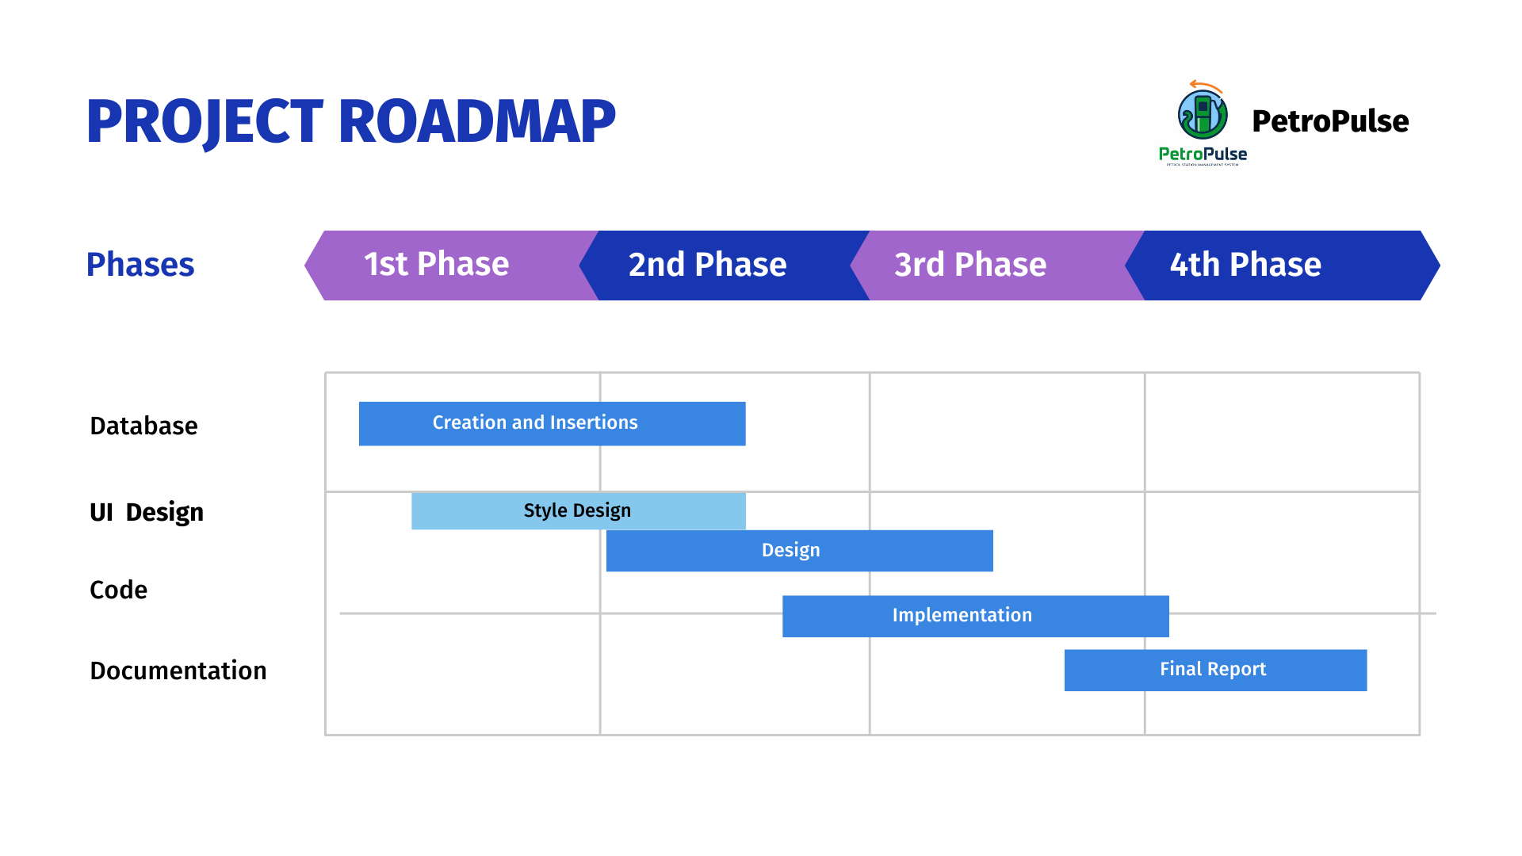
Implementation Phases

Slide 5
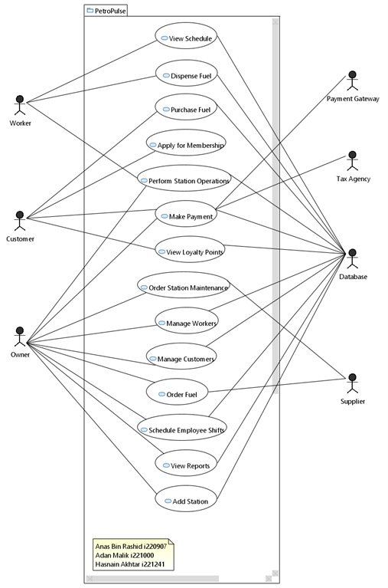
USE CASES & USE CASE DIAGRAM
Apply for Membership
Purchase Fuel
Make Payment
View Loyalty Points
Dispense Fuel
View Schedule
Perform Station Operations
Set Employee Schedule
Manage Customers
Manage Workers
Order Fuel
Order Maintenance
View Reports
Add Fuel Station

Slide 6
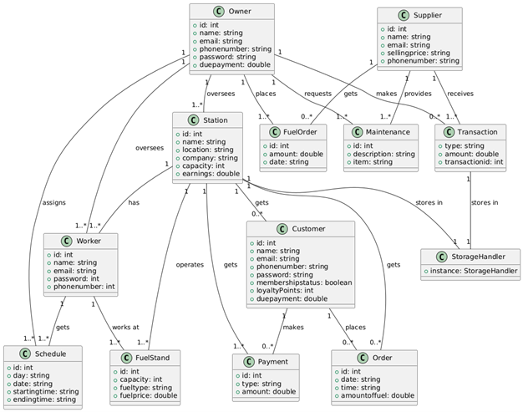
DOMAIN MODEL

Slide 7
SEQUENCE DIAGRAMS

Slide 8
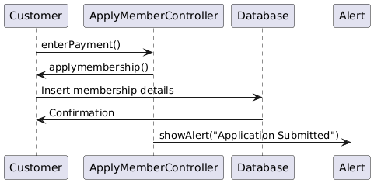
Apply For Membership

Slide 9
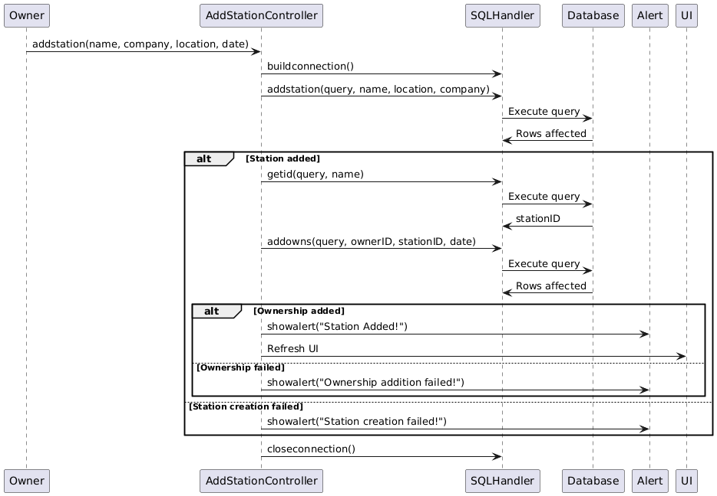
Add Fuel Station

Slide 10
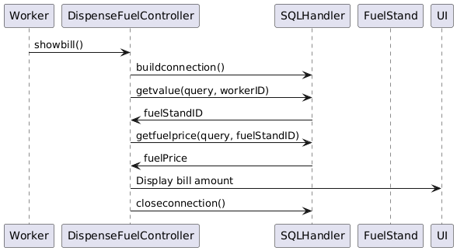
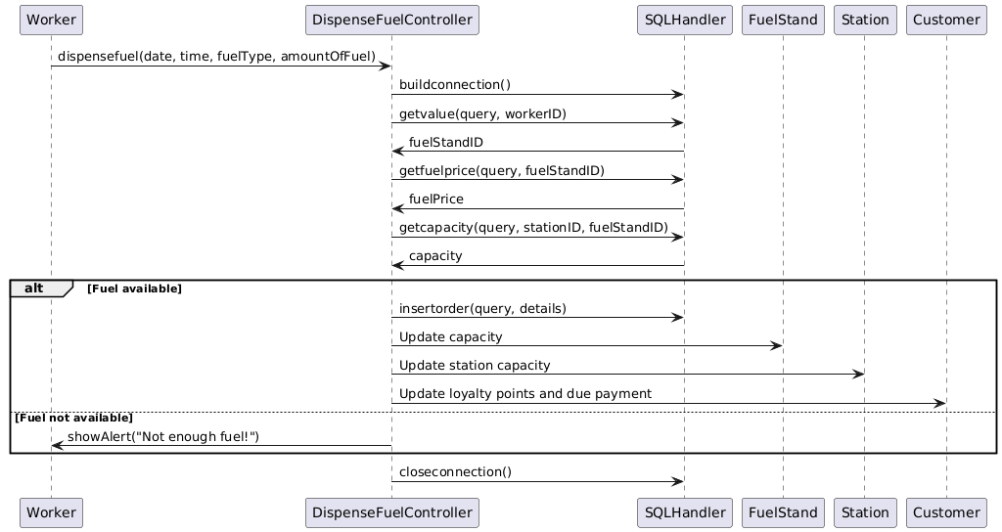
Dispense Fuel

Slide 11
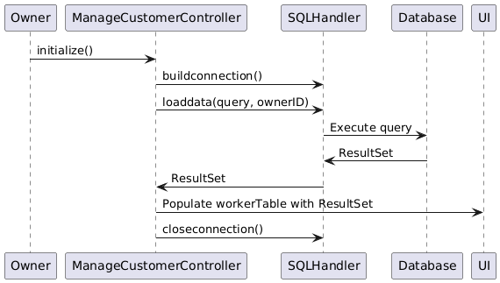
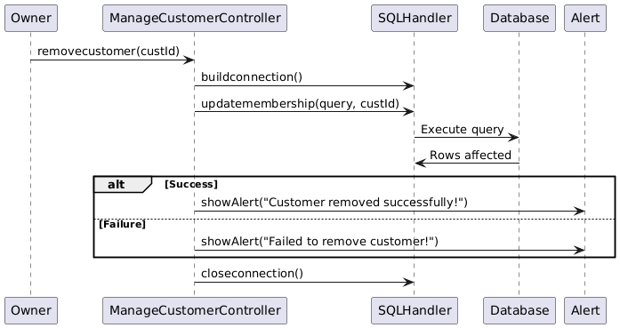
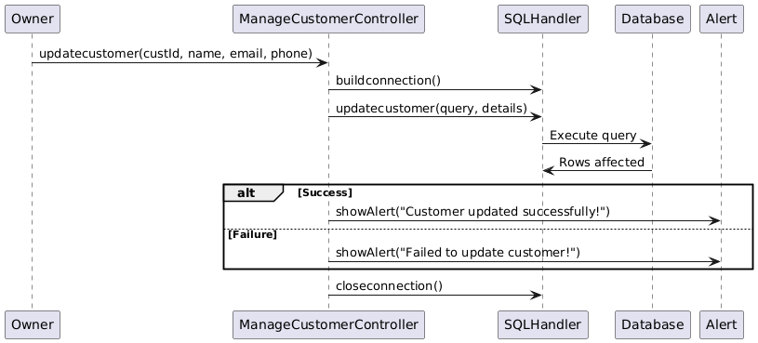
Manage Customers

Slide 12
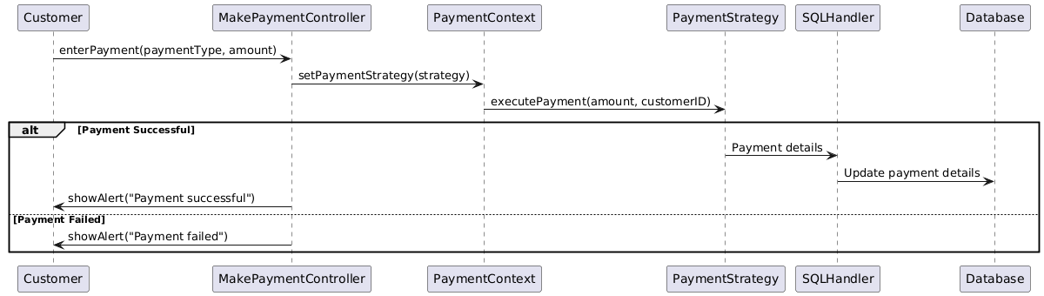
Make Payment

Slide 13
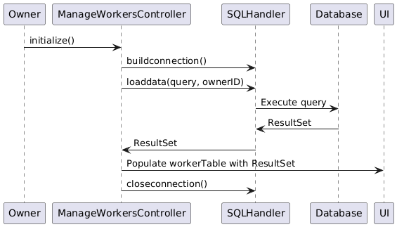
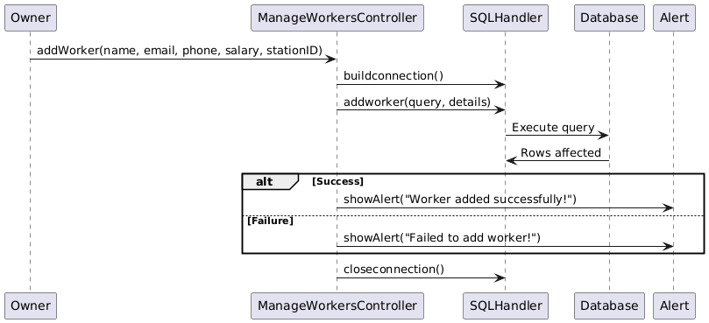
Manage Workers

Slide 14
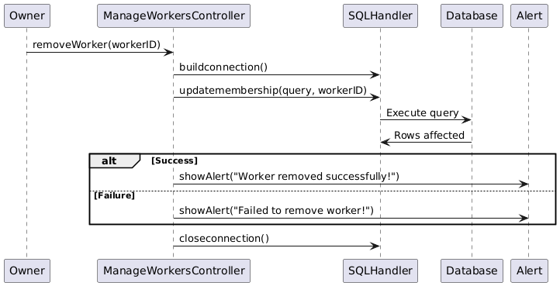
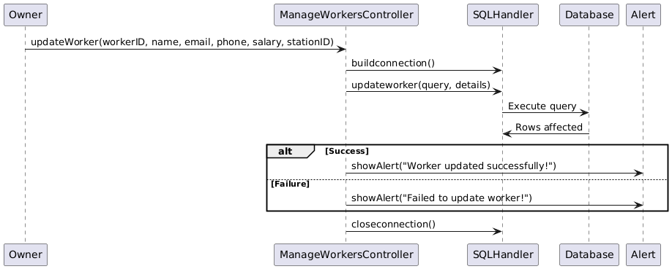
Manage Workers

Slide 15
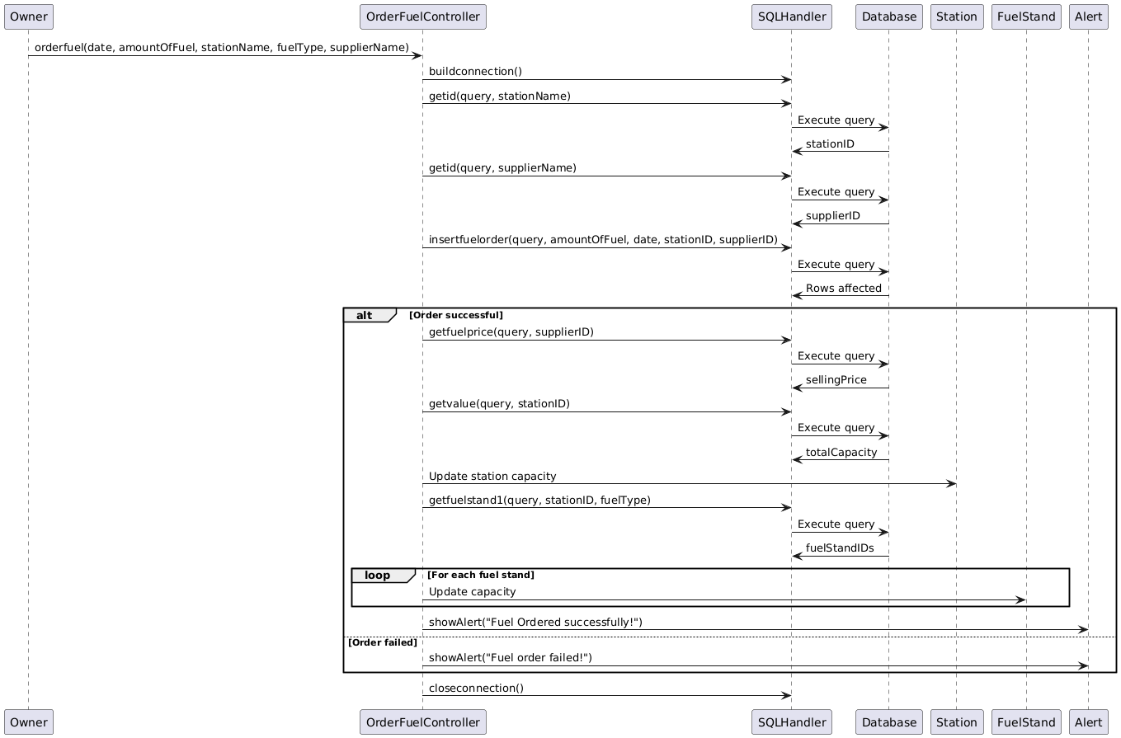
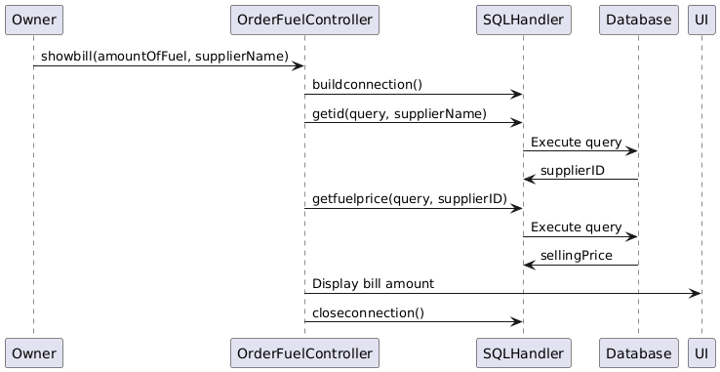
Order Fuel

Slide 16
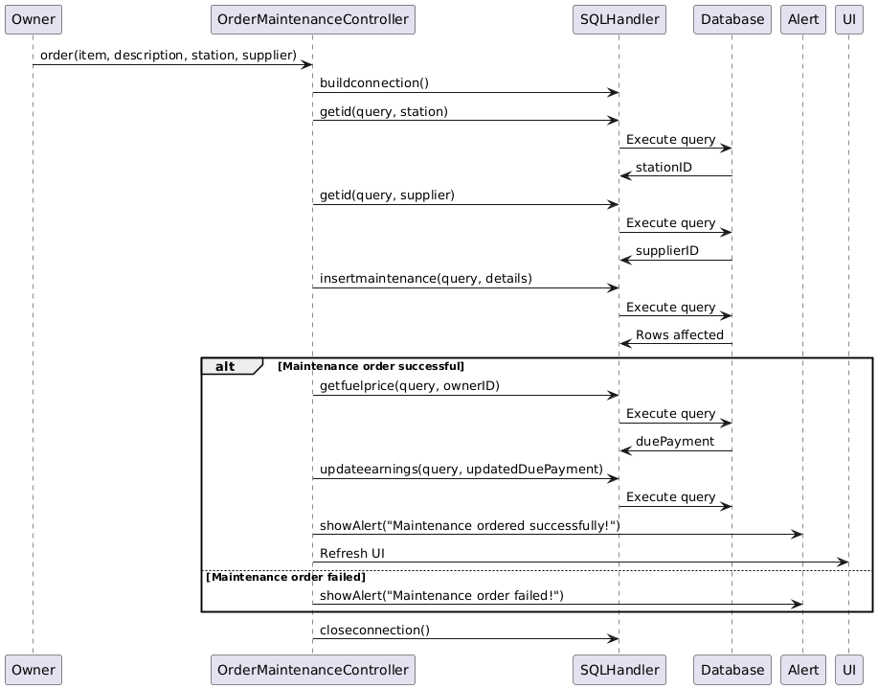
Order Maintenance

Slide 17
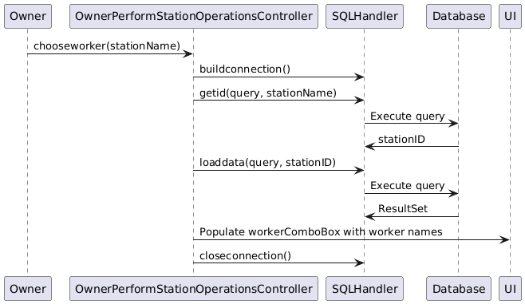
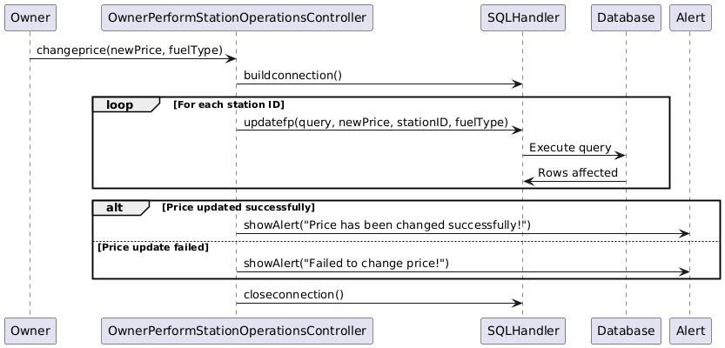
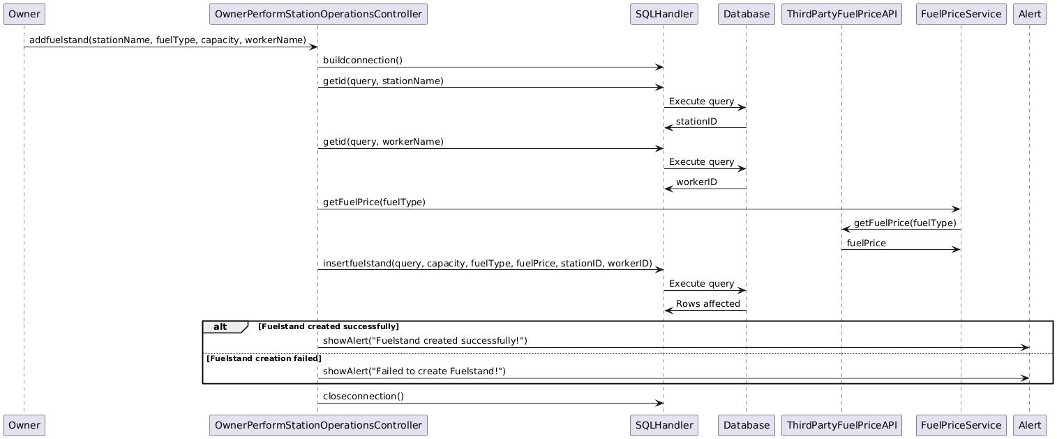
Owner Performs Station Operations

Slide 18
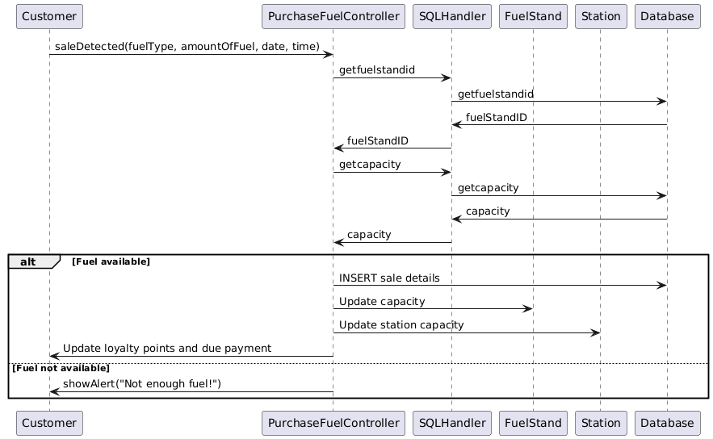
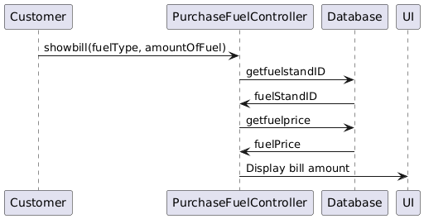
Purchase Fuel

Slide 19
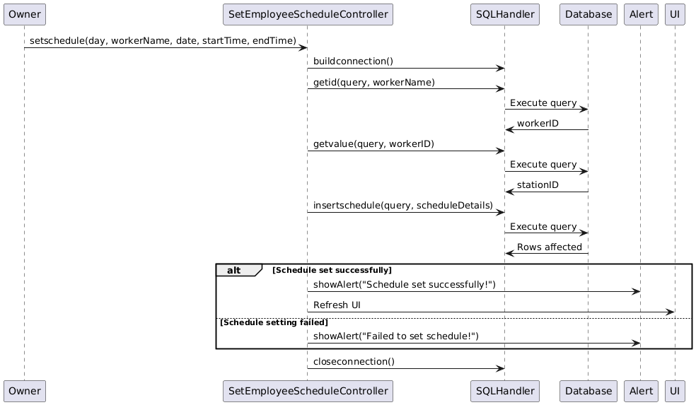
Set Employee Schedule

Slide 20
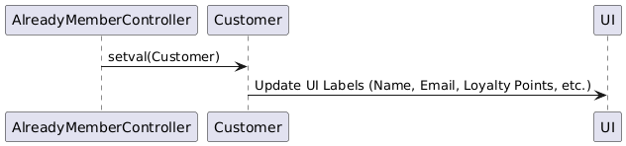
View Loyalty Points

Slide 21
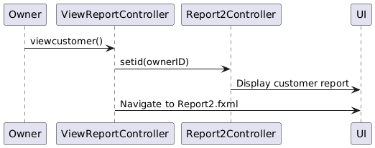
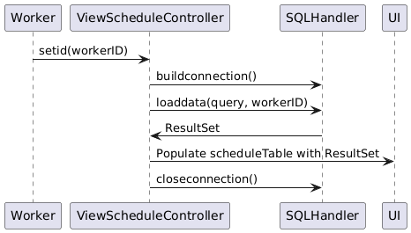
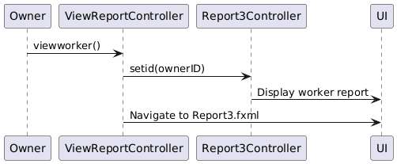
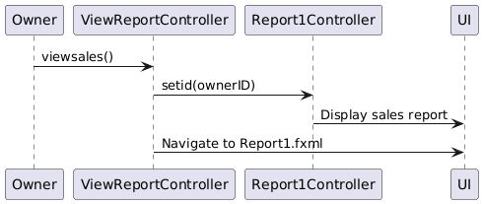
View Reports

Slide 22
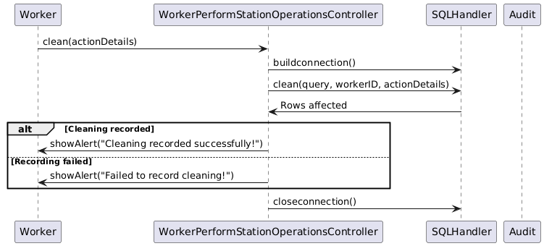
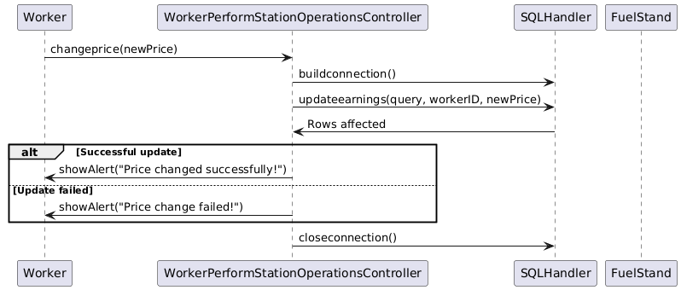
Worker Performs Station Operations

Slide 23
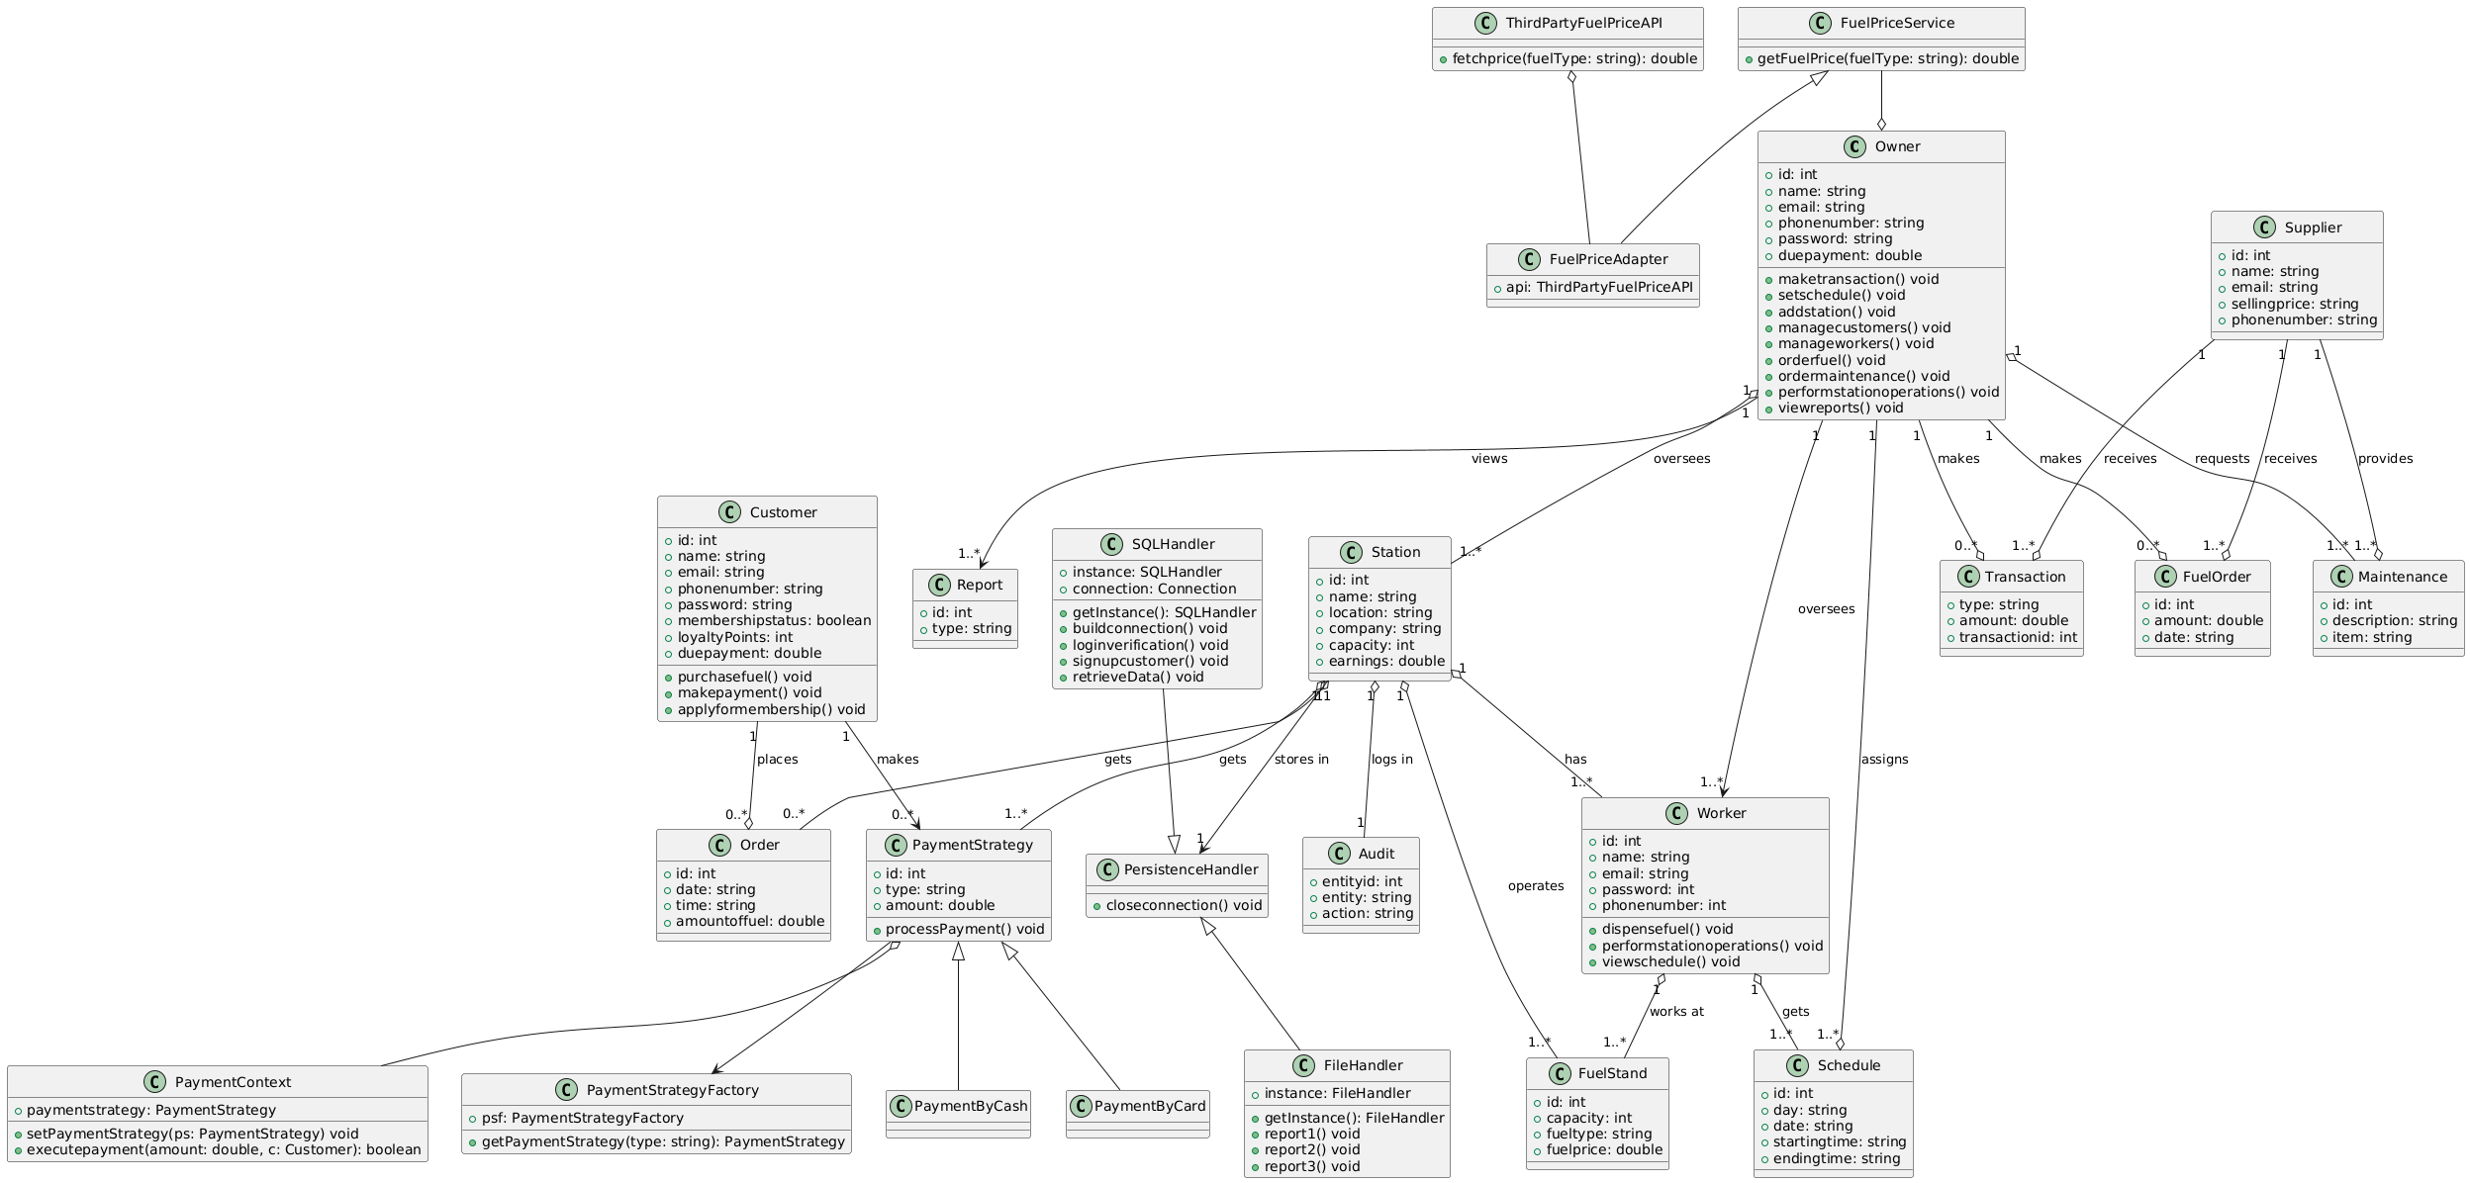
CLASS DIAGRAM

Slide 24
DESIGN PATTERNS
GRASP Patterns
Information Expert (Station, Customer)
Controller (For each Use Case)
Creator (Station)
High Cohesion (Schedule, Transaction)
Low Coupling (Persistence Handler, Payment Strategy)
Polymorphism (Payment Strategy)
GOF Patterns
Singleton (SQL Handler, File Handler, Payment Method Factory)
Factory (Payment Method Factory)
Strategy (Payment Strategy, Payment Context)
Adapter (Fuel Price Adapter)

Slide 25
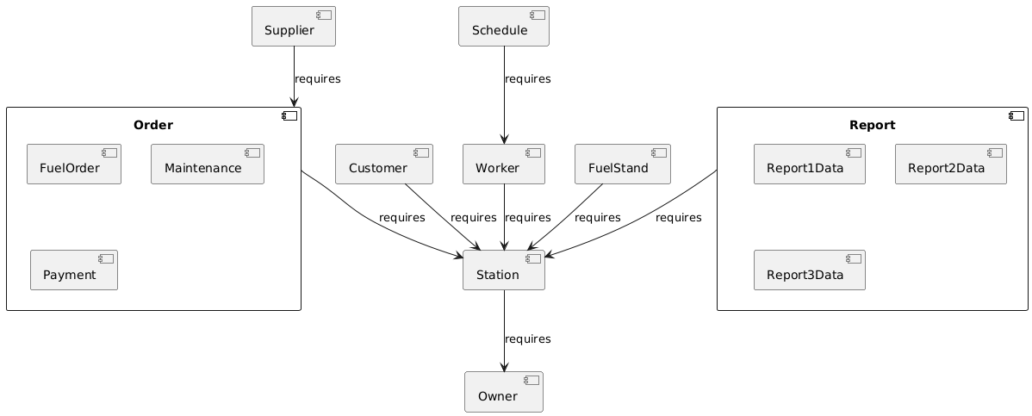
COMPONENT DIAGRAM

Slide 26
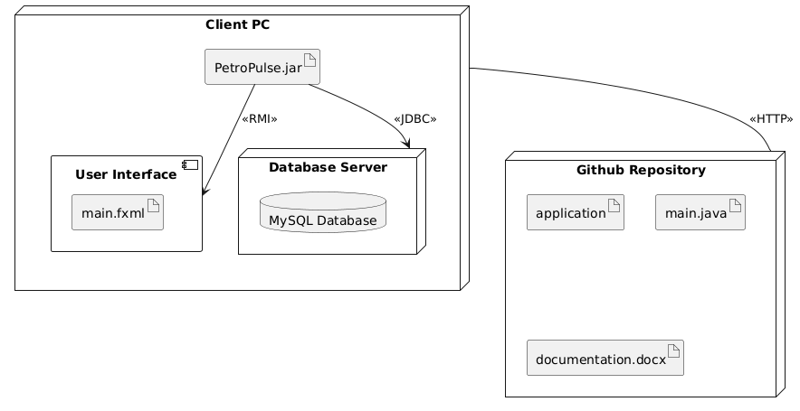
DEPLOYMENT DIAGRAM

Slide 27
USER INTERFACES

Slide 28
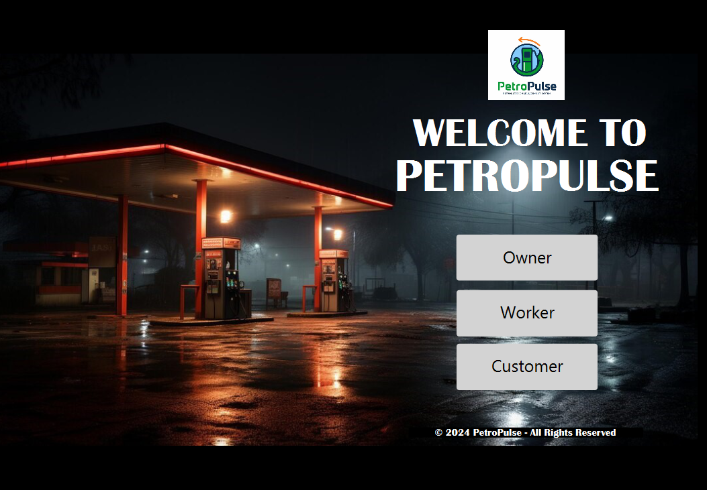
LANDING PAGE

Slide 29
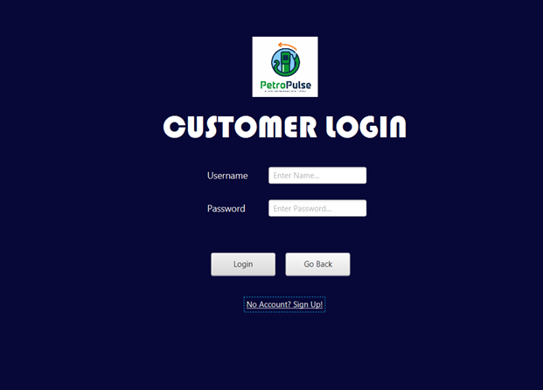
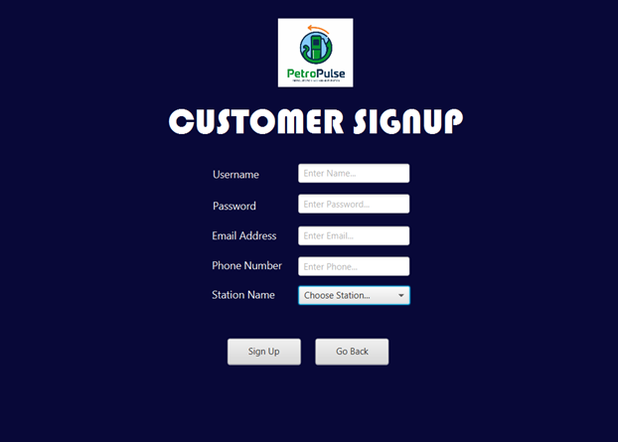
SIGNUP AND LOGIN

Slide 30
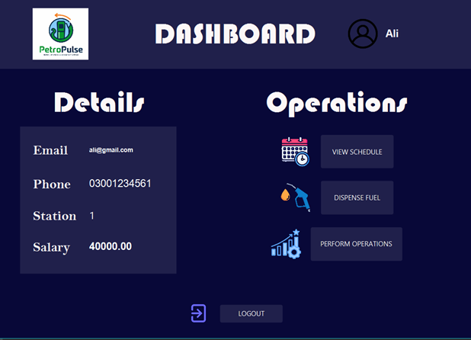
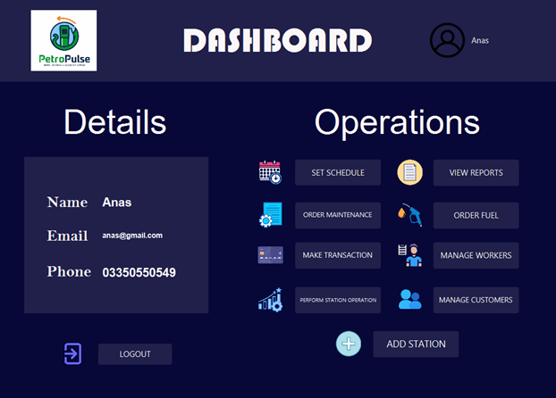
HOME PAGES

Slide 31
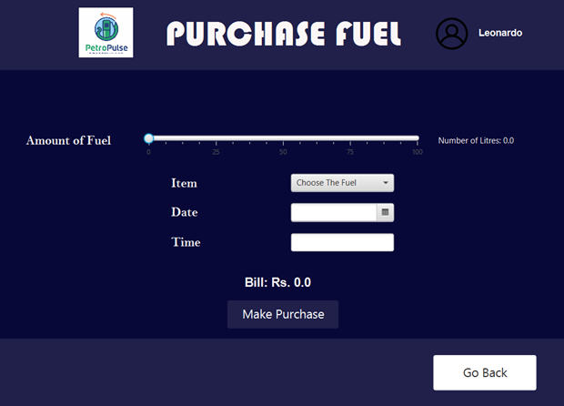
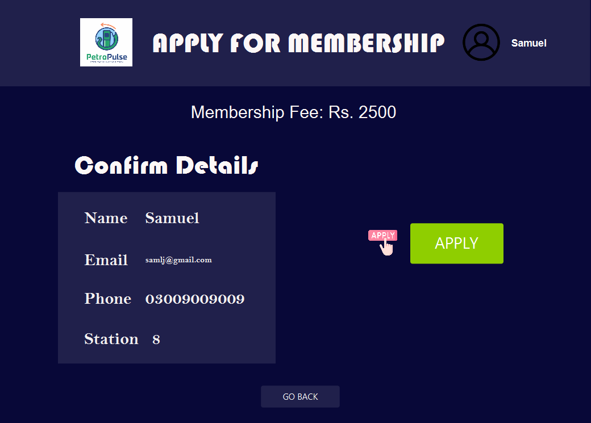
CUSTOMER OPTIONS

Slide 32
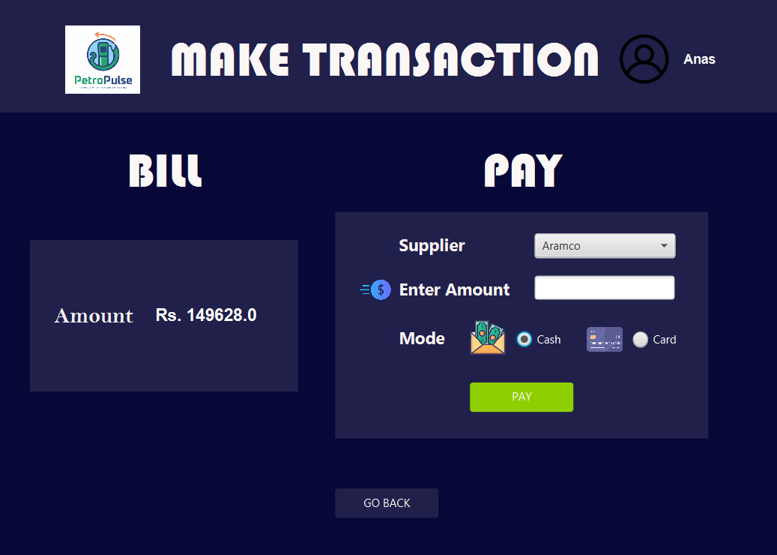
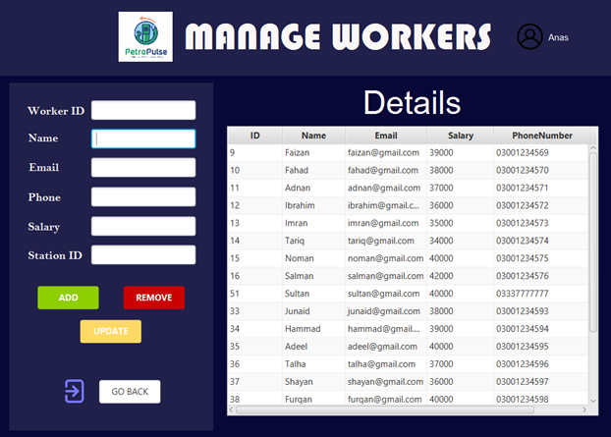
OWNER OPTIONS

Slide 33
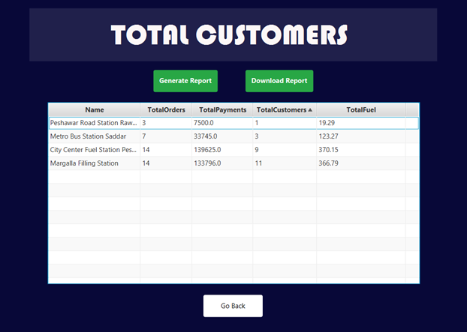
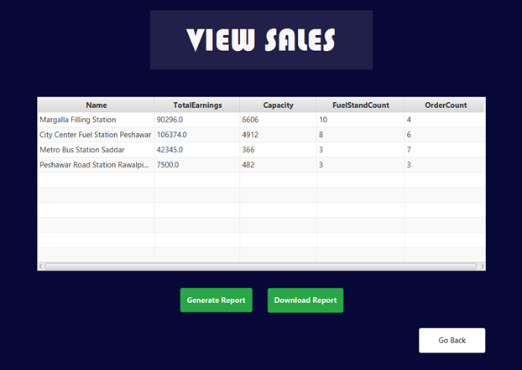
REPORTS

Slide 34
BUSINESS OBJECTIVES
Enhance Operational Efficiency: Automate and streamline petrol station processes to reduce manual workload and improve productivity.
Boost Customer Satisfaction: Provide fast, seamless transactions and loyalty programs to improve the customer experience.
Improve Financial and Inventory Management: Ensure accurate tracking of sales, expenses, and fuel inventory for better oversight and decision-making.
Drive Business Growth: Expand market reach through scalable solutions and generate revenue from licensing, maintenance, and partnerships.

Slide 35
NON-FUNCTIONAL REQUIREMENTS
The system should handle concurrent usage and ensure fast transaction processing.
It must prioritize data privacy, secure payment transactions, and encrypted communication.
User authentication and role-based access control are essential for security.
Additionally, the system should be maintainable, scalable, reliable.
The system should have an intuitive user interface.

Slide 36
CONCLUSION
In conclusion, PetroPulse offers a comprehensive, automated solution that streamlines petrol station operations, enhances customer satisfaction, and improves financial and inventory management. By addressing key industry challenges, it provides a scalable platform for growth and efficiency. The project aims to revolutionize petrol station management for a more efficient and profitable future.

